Slide 1

Electric Vehicle Support Infrastructure

Slide 2
Task 1 : Basic Analysis

Slide 3
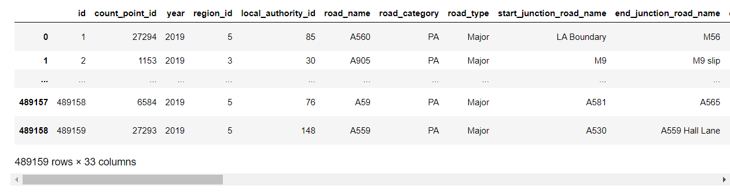
Data Cleaning
AADF Data – Major and Minor Roads
Had to clean null values
Dropped minor roads and ramp column
(Road traffic statistics)

Slide 4

Data Cleaning
Traffic volume formula :-
With this we can find the annual mileage
(Road Traffic Estimates)

Slide 5
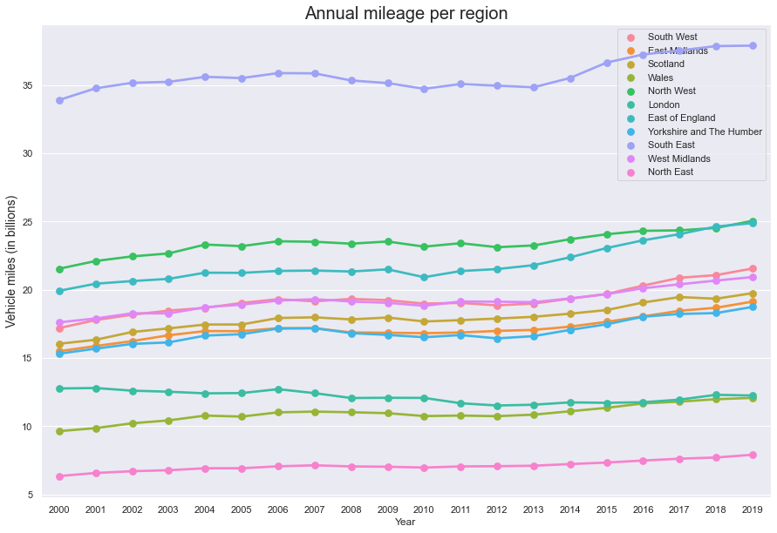
Annual mileage per region
South East highest with 38 billion miles in 2019.
North East lowest with 7.5 billion miles in 2019.
Constant increase through all regions.

Slide 6
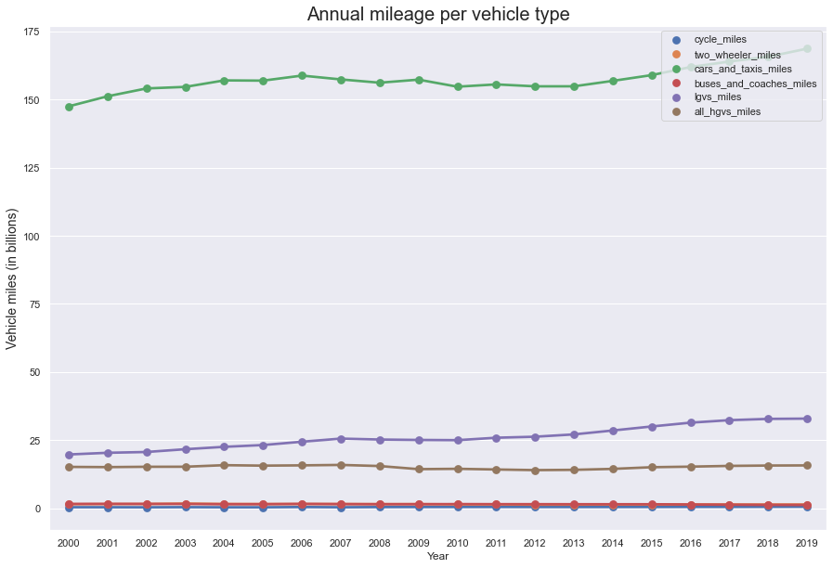
Annual mileage per vehicle type
Cars and taxis have much higher annual miles of 160 billion in 2019.
Cycles have the lowest miles of less than 5 billion miles in 2019.
Varied trends for vehicle types.

Slide 7
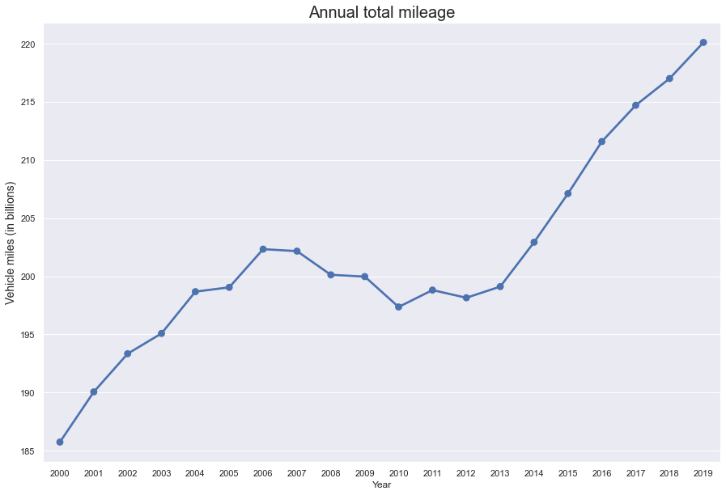
Annual mileage for all vehicle type
186 billion miles in 2000 whereas 220 billion miles in 2019.
Steadily rose as a result of increased population and affordability of vehicles.
Dipped in 2008-2012 because of economic crisis.

Slide 8
Task 2 : Regression

Slide 9
ARIMA Model
Autoregressive Integrated Moving Average
Data is a time series.
Uses past trends to forecast the future.
Limitation : Does not consider external factors.

Slide 10
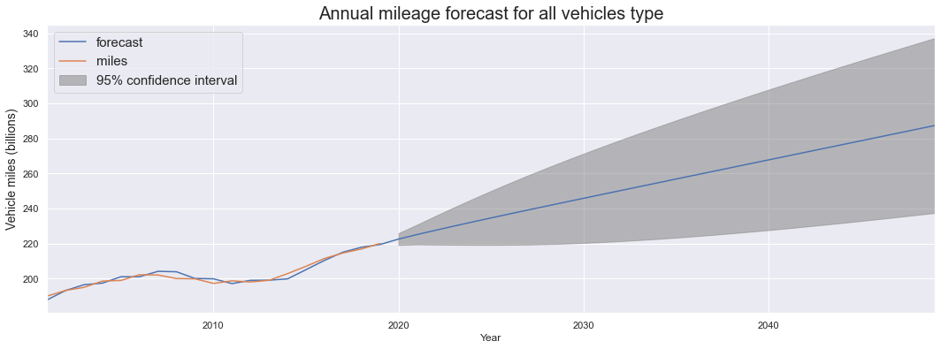
Forecast for 2050
220 billion miles in 2020.
Estimated to be 287 billion miles by 2050.

Slide 11
Task 3 : Research

Slide 12
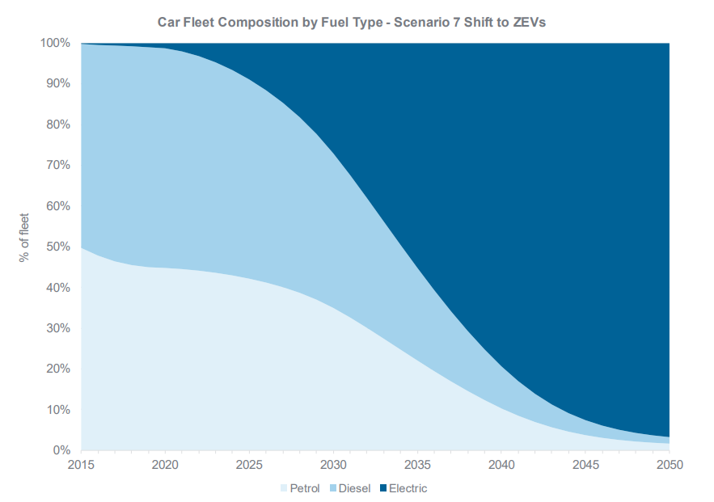
Percentage of expected electric vehicles
0.4 % of all vehicles are electric in 2015.
Estimated to be 97% by the year 2050.
(Road Traffic Forecasts 2018 pg. 42)

Slide 13
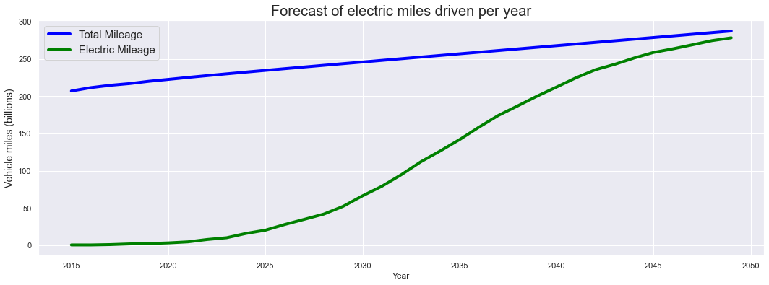
Forecast of electric miles driven per year
Close to 2 billion miles for the year 2015.
Estimated to increase dramatically to 287 miles by 2050.

Slide 14
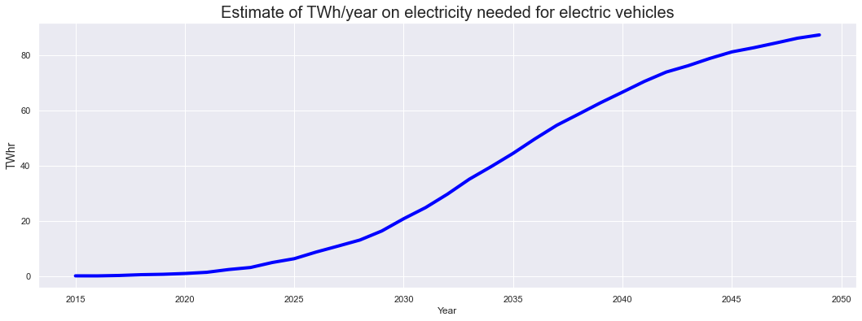
Estimate of TWh/year on electricity needed for electric vehicles
Average energy consumption of electric vehicles is 314 Wh/mi.
(EV Database UK)
80 TWhr/year estimated to be needed for electric vehicles by 2050.

Slide 15
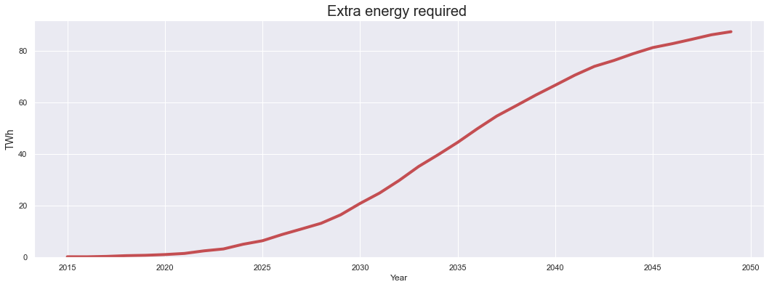
Additional energy to be generated for electric vehicles
UK’s energy supply for 2020 = energy demand for 2020 = 330 TWhr.
(DUKES 2020 Chapter 5)
Extra energy to be generated exactly equal to energy required.

Slide 16
Task 4 : Reccomendation

Slide 17
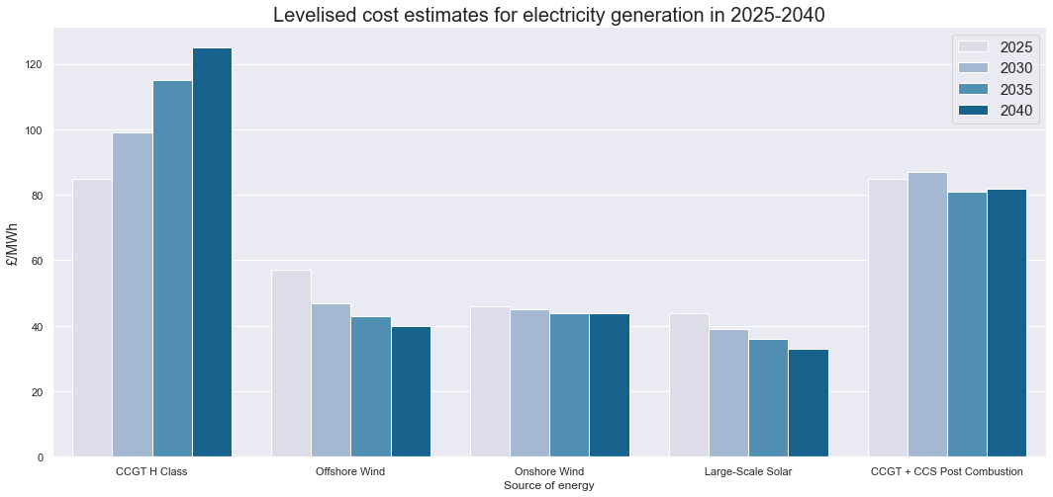
Levelized cost estimates for electricity generation
Solar energy best in terms of cost efficiency by 2040.
Offshore wind followed by Onshore wind is close runner up.
CCGT H class has the worst cost efficiency.
(BEIS Electricity Generation Costs 2020 Section 4 (page 27- 35))

Slide 18
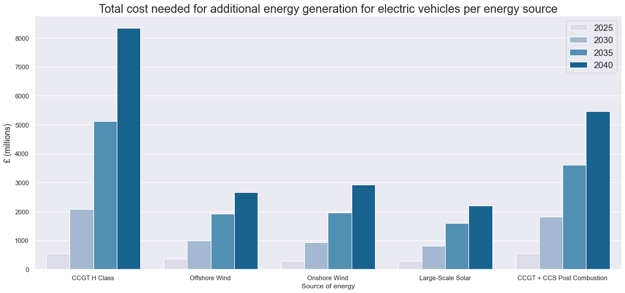
Total cost for additional energy generation for electric vehicles per energy source
Solar cheapest.
CCGT H class costliest.

Slide 19
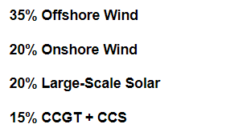
Optimal energy source ratio
Solar energy unreliable.
Offshore > Onshore in terms of energy output.
CCGT H class not cost efficient as well as harmful to environment.

Slide 20
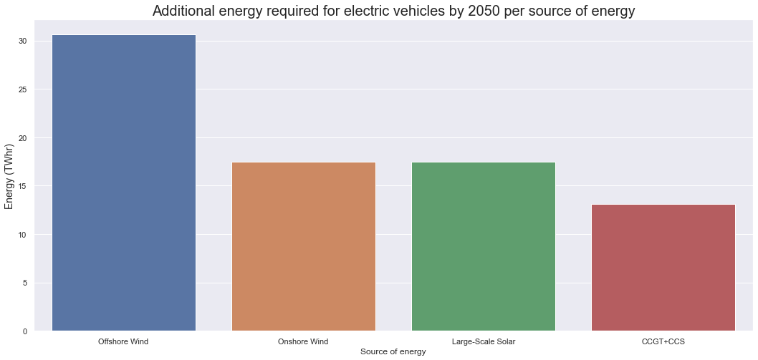
Additional energy required for electric vehicles by 2050 per source of energy
Offshore wind should generate more than 30 TWhr energy.
CCGT+CCS should only generate 12.5 TWhr energy.

Slide 21
END

